Slide 1

Understand Airbnb – an in-depth overview of the Chicago market
Presenters: Chloe Huang, Lauren Sample, Yujie Huang, Yifan Gao

Slide 2

AGENDA
Introduction
Data Analysis Processes
Business Insights
Recommendations & Conclusions

Slide 3
Background
Airbnb has reshaped millions of travelers' accommodation preferences around the world and enable a new group of people to become hosts in the sharing economy model.
Hosts are currently suffering because of the worldwide pandemic. The lock-down of cities discourage travelers to book listings resulting in vast decreases in host income.

Slide 4
Business Use Case THE FINAL GOALS OF ANALYSIS AND THE POTENTIAL IMPACTS
Our primary goals are to understand the local Airbnb market, learn from the existing listings’ characteristics and draw out the predictors which impact on properties popularity.
Our target audience includes Airbnb individual hosts, Airbnb property management companies and Real Estate investors who are trying to diversify their investments in the Chicago area.

Slide 5









Tools Apply for Analysis
Data Resources
Prepare & Clean Raw Data
Link: http://insideairbnb.com/get-the-data.html
Data Warehouse
BUSINESS OPERATION DATA
Listings.csv | Information for listings in Chicago
Reviews.csv | Review data and listing ID
Data Modeling & Analysis
Link: https://data.cityofchicago.org/browse?tags=shapefiles
Data Visualization & Dashboard
NON-BUSINESS DATA
geo_export.shp | Neighborhood list for geo filter. Sourced from city or open-source GIS files.
Reporting & Final Delivery

Slide 6

Data Analysis Process
Prepare & Clean Data
Database Schema

Slide 7

Prepare Data
Raw Data Overview
"Listings.csv" (6295 records) contains detail information about each listed property on the website in Chicago. It includes Properties' features, host information, occupancy history and general review from previous guests.
"Reviews.csv" (270014 records) contains listing id and review date chronologically.
Data reflects the snapshot on Oct. 24th, 2020.
Data is web scraped by individual contributor online from Airbnb website.
“geo_export.shp” contains geological data for Chicago neighborhood.

Slide 8
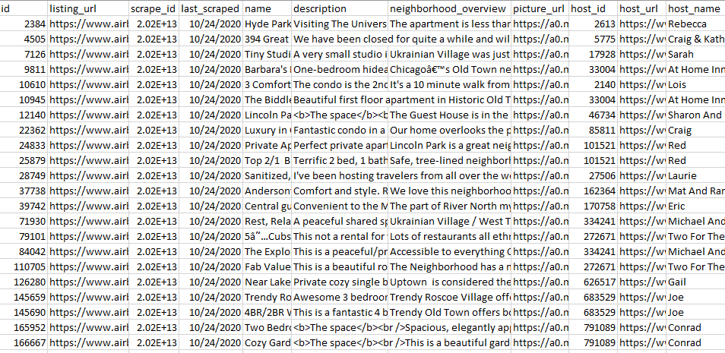
Snapshot of Listings Data

Slide 9
Data Clean Up Process
Problems | Target Data | Actions and Results
Unused and empty data columns | Listings.csv | 39 columns are removed
White spaces appear in several columns | Listings.csv | Trim white spaces with Openrefine
Messy data for State and Country (i.e. “IL”, “Illinois”, “ILLINOIS”) | Listings.csv | Cluster and merge with Openrefine
Multi elements exist in the cell for column “Amenity” (i.e. ["Dryer", "Iron", "Wifi"]) | Listings.csv | Flatten the list and map the elements to listing_id with Python
Inconsistent “N/A” and empty values | Listings.csv | Convert them to NULL so that MySQL can parse correctly
Date format was not ideal for MySQL data load | Listings.csv | Convert the format to ‘yyyy-mm-dd’ so that MySQL can parse
Unrecognized characters for column “Amenity” (i.e. "\u2019", “\", " \u2013") | Listings.csv | Translate them to readable characters with string replace

Slide 10

Database Schema
Normalization
Normalized entity-relationship model is selected as it’s easy to implement.
Normalization to 3NF+ to create 10 tables
10 tables are listing, listing_amenity, amenity, property, room, review, review_date, neighbourhood, city and host

Slide 11
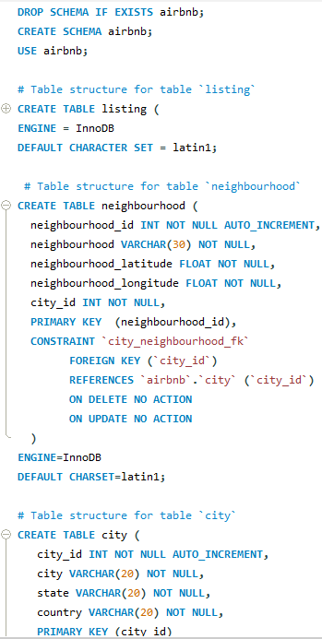
DDL Schema
Database tables
Listing: stores detailed info tied to each listing
Listing_amenity: joint table between listing and amenity
Amenity: stores amenity data
Property: stores property type data
Room: stores room type data
Review: stores detailed info tied to the review for each listing
Review_date: stores review data chronologically
Neighbourhood: stores neighbourhood and it’s longitude and latitude
City: stores city, state and country
Host: stores detailed info tied to each host

Slide 12
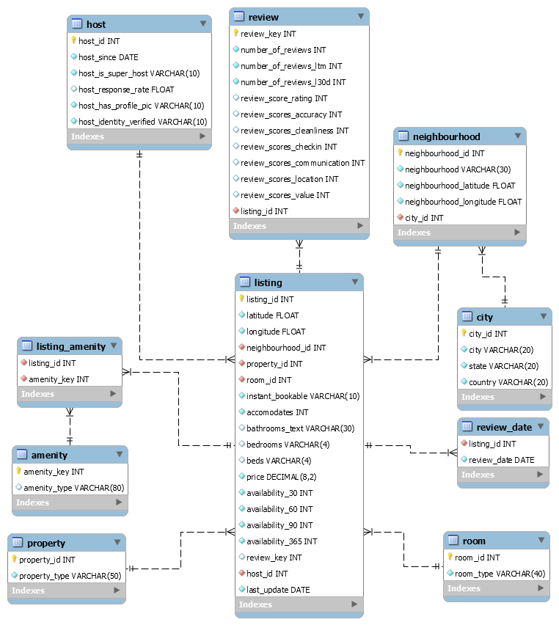
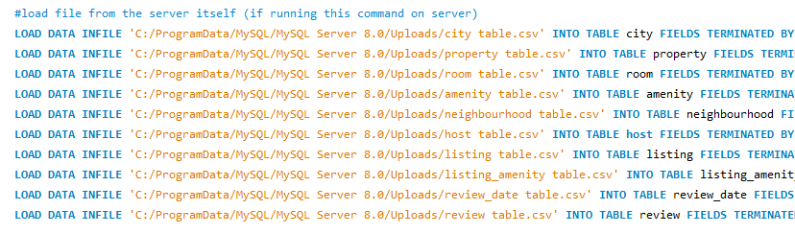
DML Schema and EER Diagram
Database tables
Original data source was split into 10 csv files using Excel and Python and they are placed to the server directory
Data is uploaded with DML schema and LOAD DATA INFILE method

Slide 13

Business Insights
WHAT ARE EXTRACTED FROM VISULIZATION AND DATA MODELING

Slide 14

Understanding the Market in Chicago Area
01
Understanding Guests Preferences
02

Slide 15
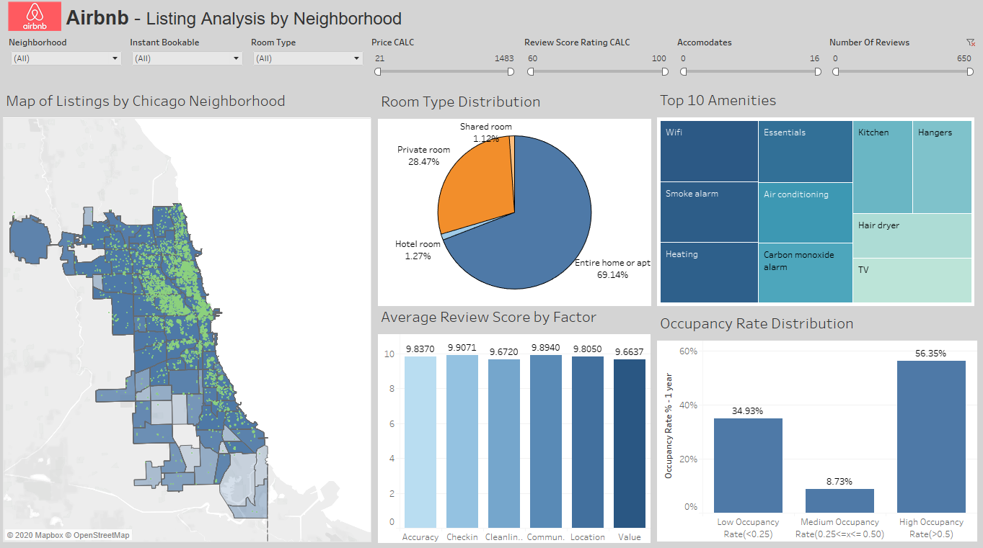
Understanding Chicago Market – Tableau Dashboard

Slide 16
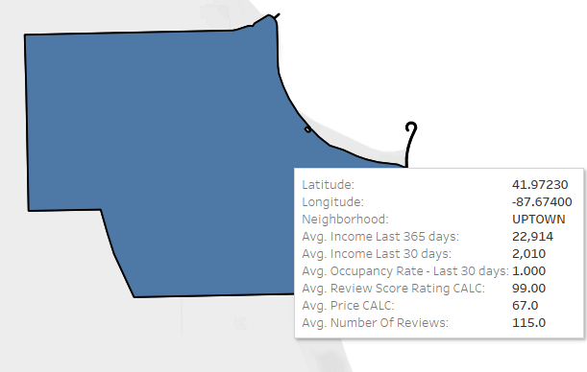
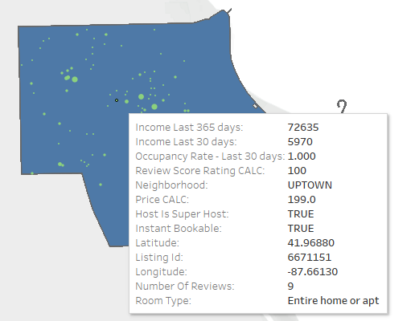
Explore Detailed Metrics by Neighborhood
Information for every listing within the specified neighborhood is displayed via layered Tableau map.
Geographical map shows overall metrics for each neighborhood in Chicago.

Slide 17
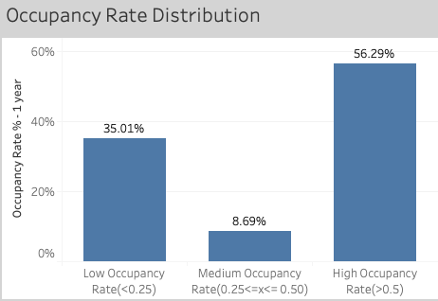
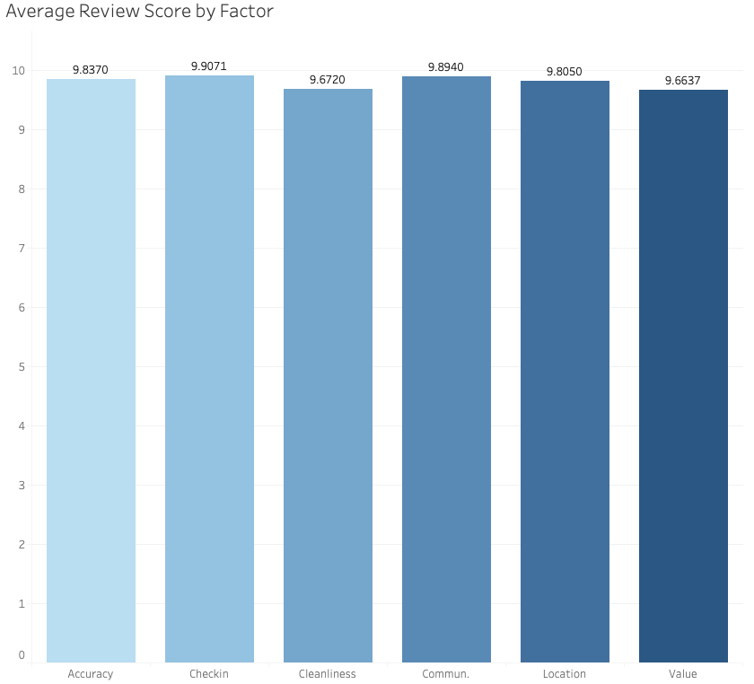
Explore Guest Choice

Slide 18
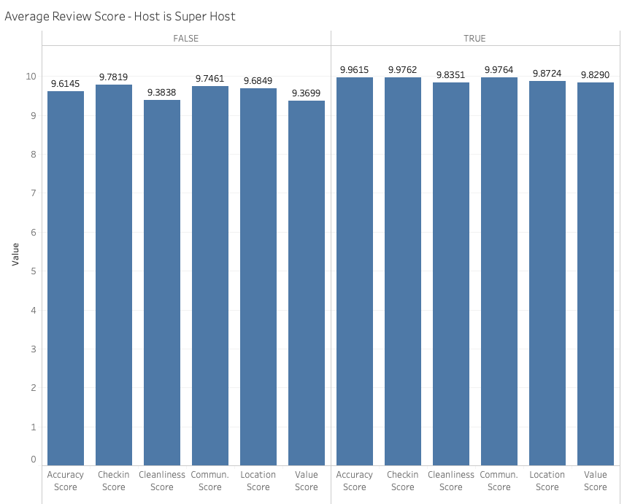
Super-Host Effects on Overall Review Score
Review scores are very sensitive to whether host is a super-host and overall
Review scores are 4% lower when host is not a super host.
Notes:
https://www.airbnb.com/help/article/829/how-do-i-become-a-superhost

Slide 19
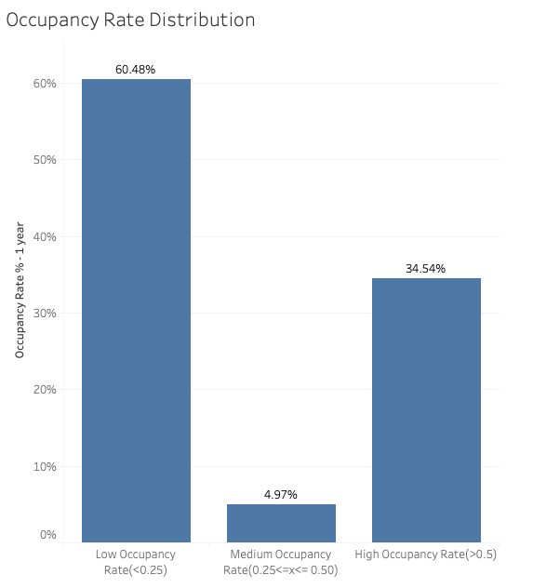
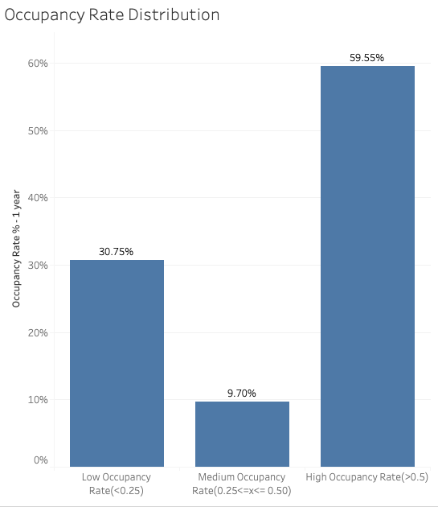
Occupancy Rate
Occupancy rate is sensitive to the number of people the listing can accommodate. The more people the listing can accommodate, the lower the occupancy rate
Accommodates = 16
Accommodates = 3

Slide 20
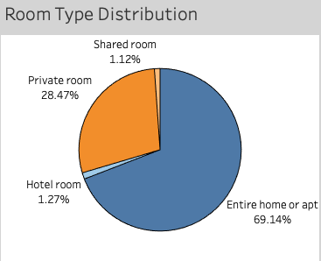
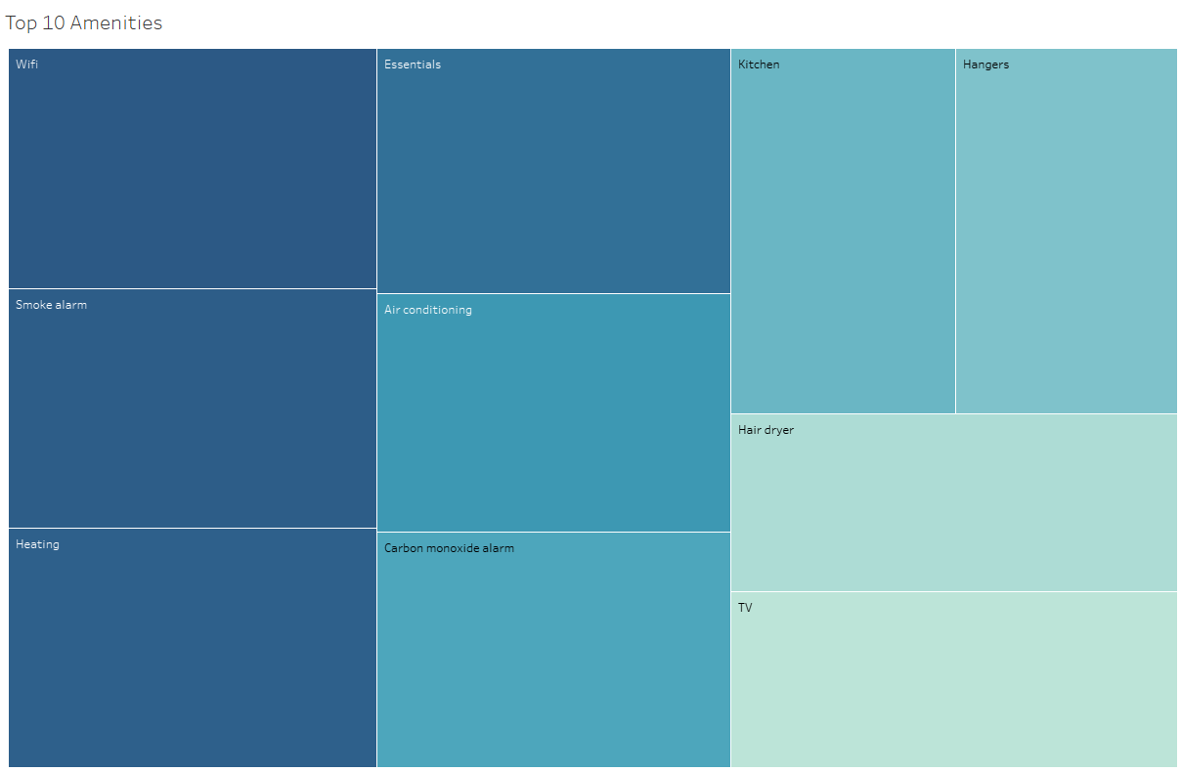
Room Type & Top 10 Amenities
The popularity for room type in terms of number of reviews has the same sequence with the pie chart on the left.
Top 10 amenities account for 33% of all amenities.

Slide 21
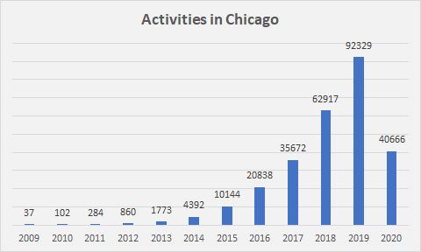
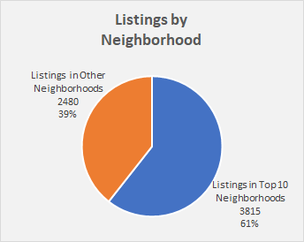
Understanding Chicago Market
The market revenue in Chicago in 2020 is $303,729
Near half of the listed properties locate in top 10 neighborhoods (most listing view)
Income of top 10 neighborhoods hosts have much higher annual income
Total listed Properties in Chicago
6295
Average Overall Chicago Occupation Rate in Past 365 Days
48.85%
Average Top 10 Neighborhoods Occupation Rate in Past 365 Days
46.54%
Average Host Annual Income in Chicago
$ 19,717.10
Average Host Annual Income in Top 10 Neighborhood
$ 30,372.92
Neighborhood (Top 10)
1 | Near North Side
2 | West Town
3 | Lake View
4 | Logan Square
5 | Loop
6 | Near West Side
7 | Lincoln Park
8 | Lower West Side
9 | Edgewater
10 | Uptown

Slide 22
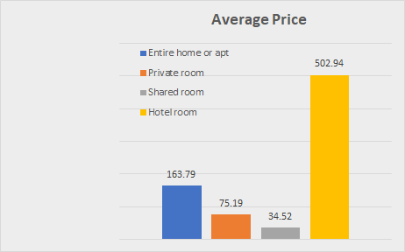
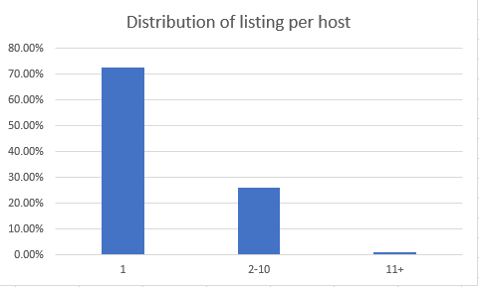
Understanding Properties
When it comes to average price, hotel room is the most expensive one, entire room is the second, private room is the third and shared room is the least.
Single listing type accounts for 73% of listing market. Multiple listing type accounts for the rest but plays a significant role in the market in terms of income.

Slide 23

Understanding Guests Preferences Data Modeling & Analysis

Slide 24
Data Modeling and Analysis
A multiple regression analysis is conducted in R against 10 independent predictors
The response is review_scores_rating
These predictors are: price, neighbourhood, number_of_reviews, room_type, accommodates, instant_bookable, host_is_superhost, host_identity_verified, host_has_profile_pic, host_response_rate, good_amenity
Good_amenity is a binary vector measured by whether the top 10 amenities are included for each listing; TRUE if included

Slide 25
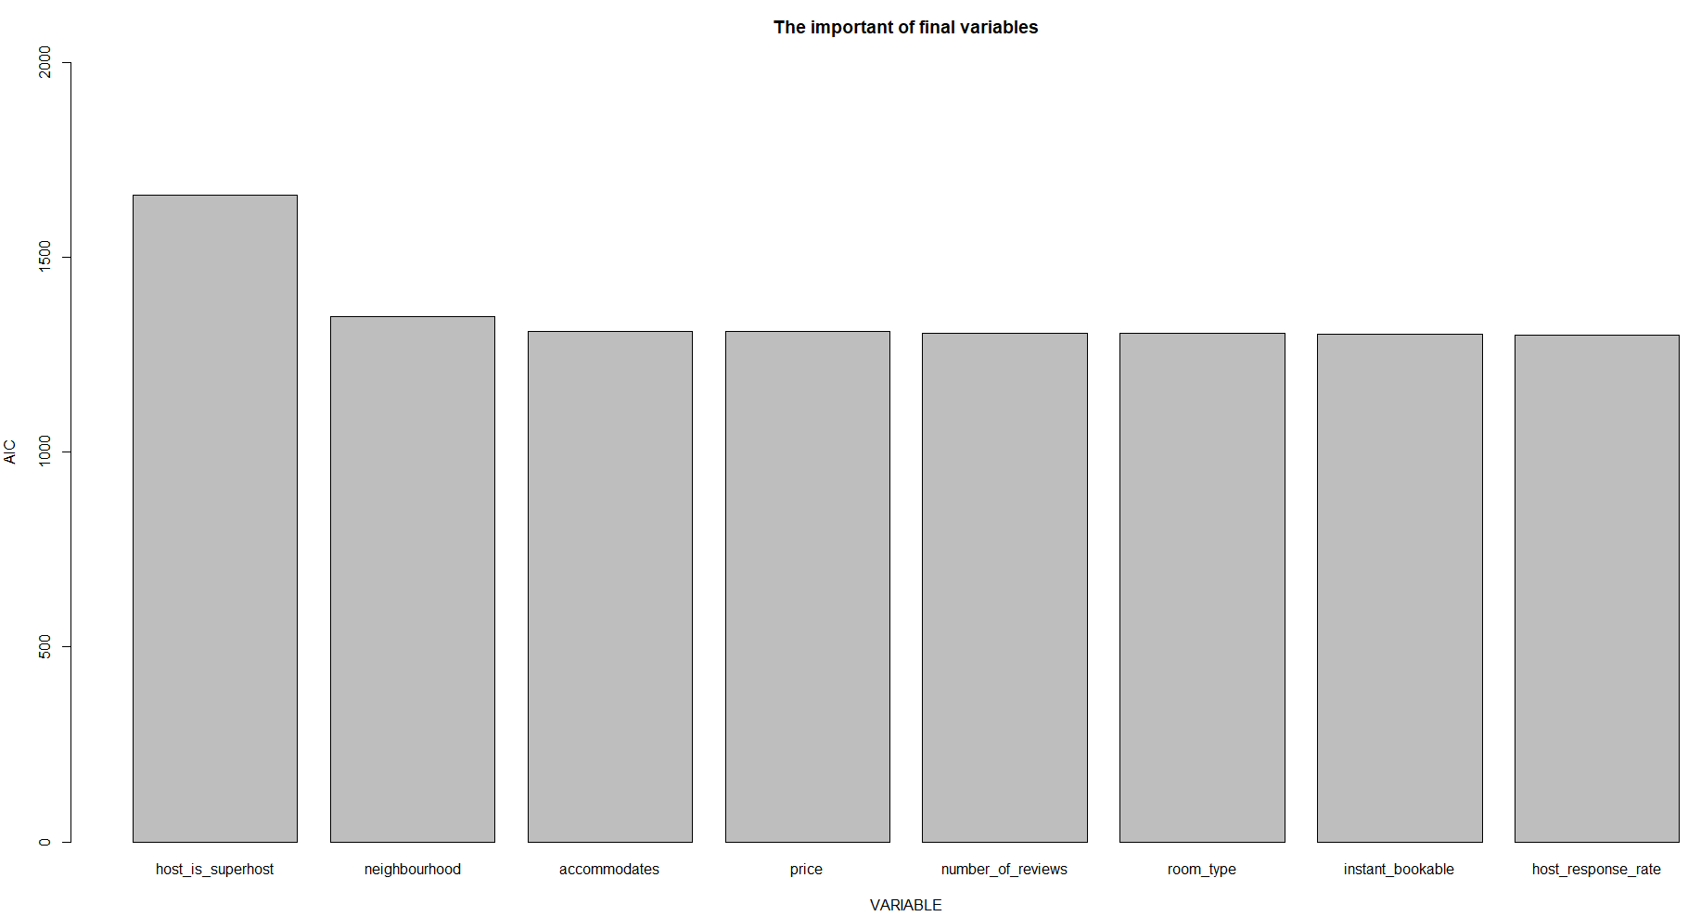
Multi regression analysis
The linear model with 10 predictors was formed initially
Use step method to drop insignificant predictors
The final predictors are: host_is_superhost, neighbourhood, accommodates, price, number_of_reviews, room_type, instant_bookable, host_response_rate
Run Farrar – Glauber test to ensure no multicollinearity presented in the final predictors
The ranking of importance for the final predictors is on the left based on Akaike information criterion

Slide 26
Multi regression analysis
Df Sum of Sq RSS AIC
<none> 3579.5 1300.5
- host_response_rate 1 12.78 3592.3 1301.2
+ host_identity_verified 1 4.72 3574.8 1301.5
+ good_amenity 1 0.24 3579.3 1302.4
- instant_bookable 1 25.77 3605.3 1304.0
- room_type 3 48.61 3628.1 1304.8
- number_of_reviews 1 33.74 3613.2 1305.7
- price 1 54.26 3633.8 1310.0
- accommodates 1 55.76 3635.3 1310.3
- neighbourhood 50 763.37 4342.9 1348.4
- host_is_superhost 1 2160.63 5740.1 1659.8
Residual standard error: 2.253 on 705 degrees of freedom
Multiple R-squared: 0.5493, Adjusted R-squared: 0.5116
F-statistic: 14.56 on 59 and 705 DF, p-value: < 2.2e-16

Slide 27
Multi regression analysis
Number of reviews | R-Square | Predictors selected
100 | 0.5493 | host_is_superhost, neighbourhood, accommodates, price, number_of_reviews, room_type, instant_bookable, host_response_rate
200 | 0.6607 | neighbourhood, number_of_reviews, accommodates, host_is_superhost, host_identity_verified, host_response_rate, good_amenity
300 | 0.8827 | neighbourhood, room_type, host_is_superhost, host_identity_verified, host_response_rate, good_amenity
The R-square and predictors selected by the model are very sensitive to the number of reviews set as a filter threshold
The higher the number of reviews, the higher the R-Square, and the lower the number of predictors selected
This may offer some insights for our clients who pay more attention to more valuable listings

Slide 28

Recommendations
Our picks on neighborhoods in terms of generating high income and attracting more listings are: Loop, Lake View, Near North Side, Uptown and West Town
For those who just enter the market or have new listings, we recommend to improve the following factors in sequence.
host_is_superhost, neighbourhood, accommodates, price, number_of_reviews, room_type, instant_bookable, host_response_rate
For experienced host, our course of recommendations changes to the following.
host_is_superhost, neighbourhood, host_response_rate, host_identity_verified, room_type, good_amenity
Notes:
1.Property Investors who eager high annual income: Loop, Lake View, Near North Side, Uptown and West Town
2.Property Investors who eager high usage rate: Lower West Side and Logan Square
3.For those who just enter the market or have new listings, we recommend putting some efforts into:
Being a super host, choose a neighborhood from what we list in the first two recommendations, host an entire home or Apt, set the price around average, respond to the guests ASAP and also encourage guests to write a review for their experience.
4. For the experienced host, we also recommend them to improve amenities in the property and the top 10 amenities from our analysis are strongly encouraged to install in their places

Slide 29
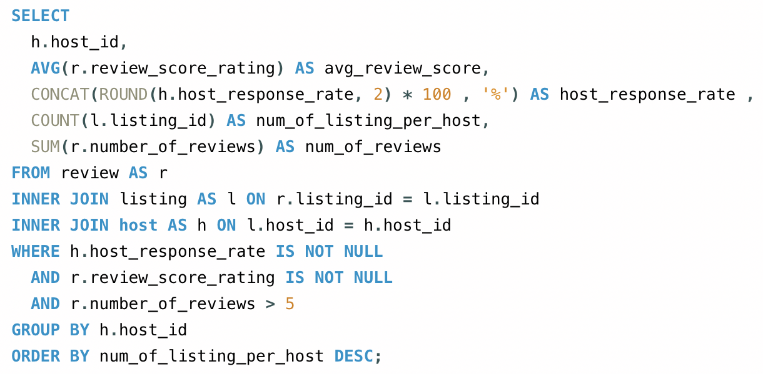
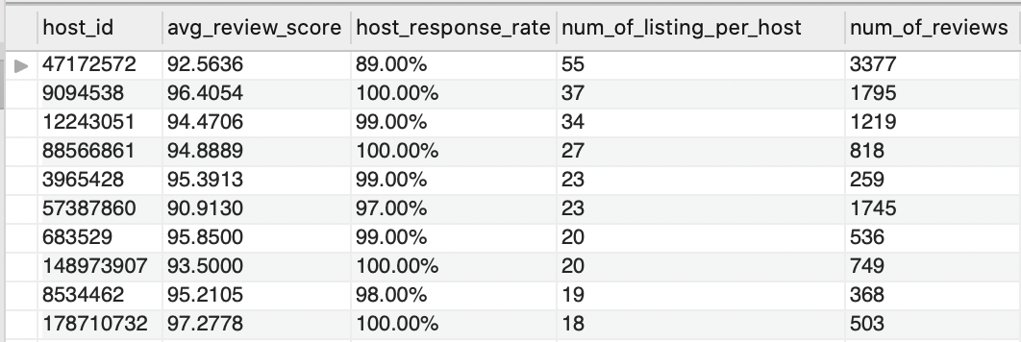
Appendix – Some SQL Queries & Output
average review score, host response rate, number of listing per host, number of reviews per host where number of reviews must be greater than 5

Slide 30
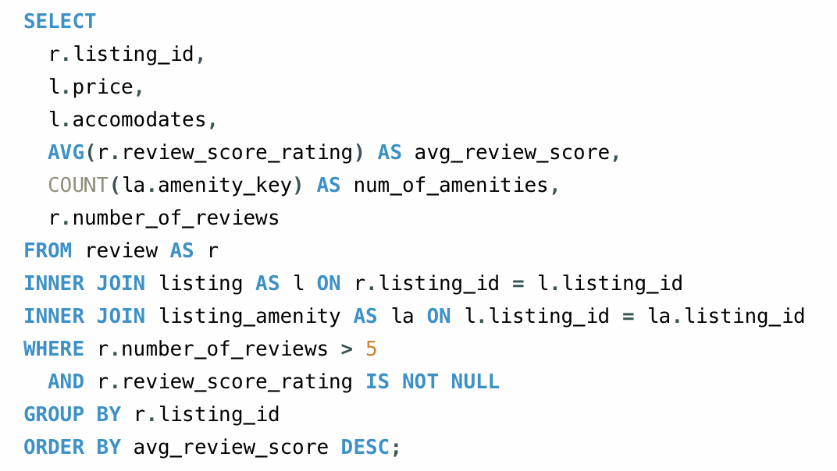
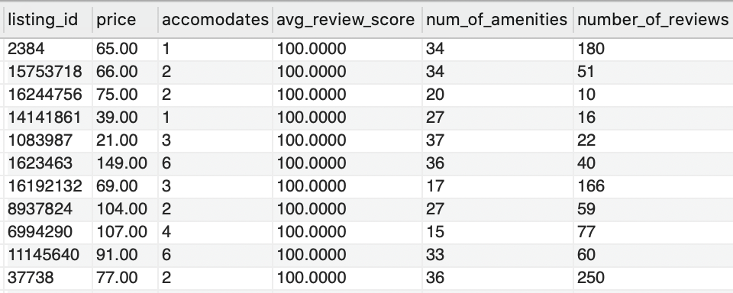
Appendix – Some SQL Queries & Output
price, accommodates, average review score, number of amenities, number of reviews per listing where number of reviews must be greater than 5

